Slide 1
Improvements to Polynomial Multiplication Through Fast Fourier Transforms
David Lambropoulos
Demetrios Lambropoulos

Slide 2
Contents
Introduction/Motivation
Theory/Algorithms
Experimental Setup
Results and Analysis
Discussion

Slide 3
Contents
Introduction/Motivation
Theory/Algorithms
Experimental Setup
Results and Analysis
Discussion

Slide 4
Introduction/Motivation

Slide 5
Contents
Introduction/Motivation
Theory/Algorithms
Experimental Setup
Results and Analysis
Discussion

Slide 6
Theory/Algorithms – Fast Fourier Transform
Let m = 2n – 1
Pick m points

Slide 7
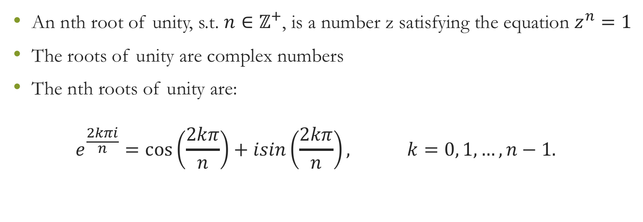
Theory/Algorithms – Roots of Unity
An nth root of unity, s.t. $n∈ℤ^{+}$, is a number z satisfying the equation $z^{n}=1$
The roots of unity are complex numbers
The nth roots of unity are: $e^{\frac{2kπi}{n}}=\cos\left(\frac{2kπ}{n}\right)+isin\left(\frac{2kπ}{n}\right), k=0, 1, …, n−1.$

Slide 8
Contents
Introduction/Motivation
Theory/Algorithms
Experimental Setup
Results and Analysis
Discussion

Slide 9
Experimental Setup

Slide 10
Contents
Introduction/Motivation
Theory/Algorithms
Experimental Setup
Results and Analysis
Discussion

Slide 11
Results and Analysis

Slide 12
Results and Analysis

Slide 13
Contents
Introduction/Motivation
Theory/Algorithms
Experimental Setup
Results and Analysis
Discussion

Slide 14
Discussion

